Slide 1
Python for Network Engineers
Getting started with Network Automation

Slide 2
Introduction to Python

Slide 3
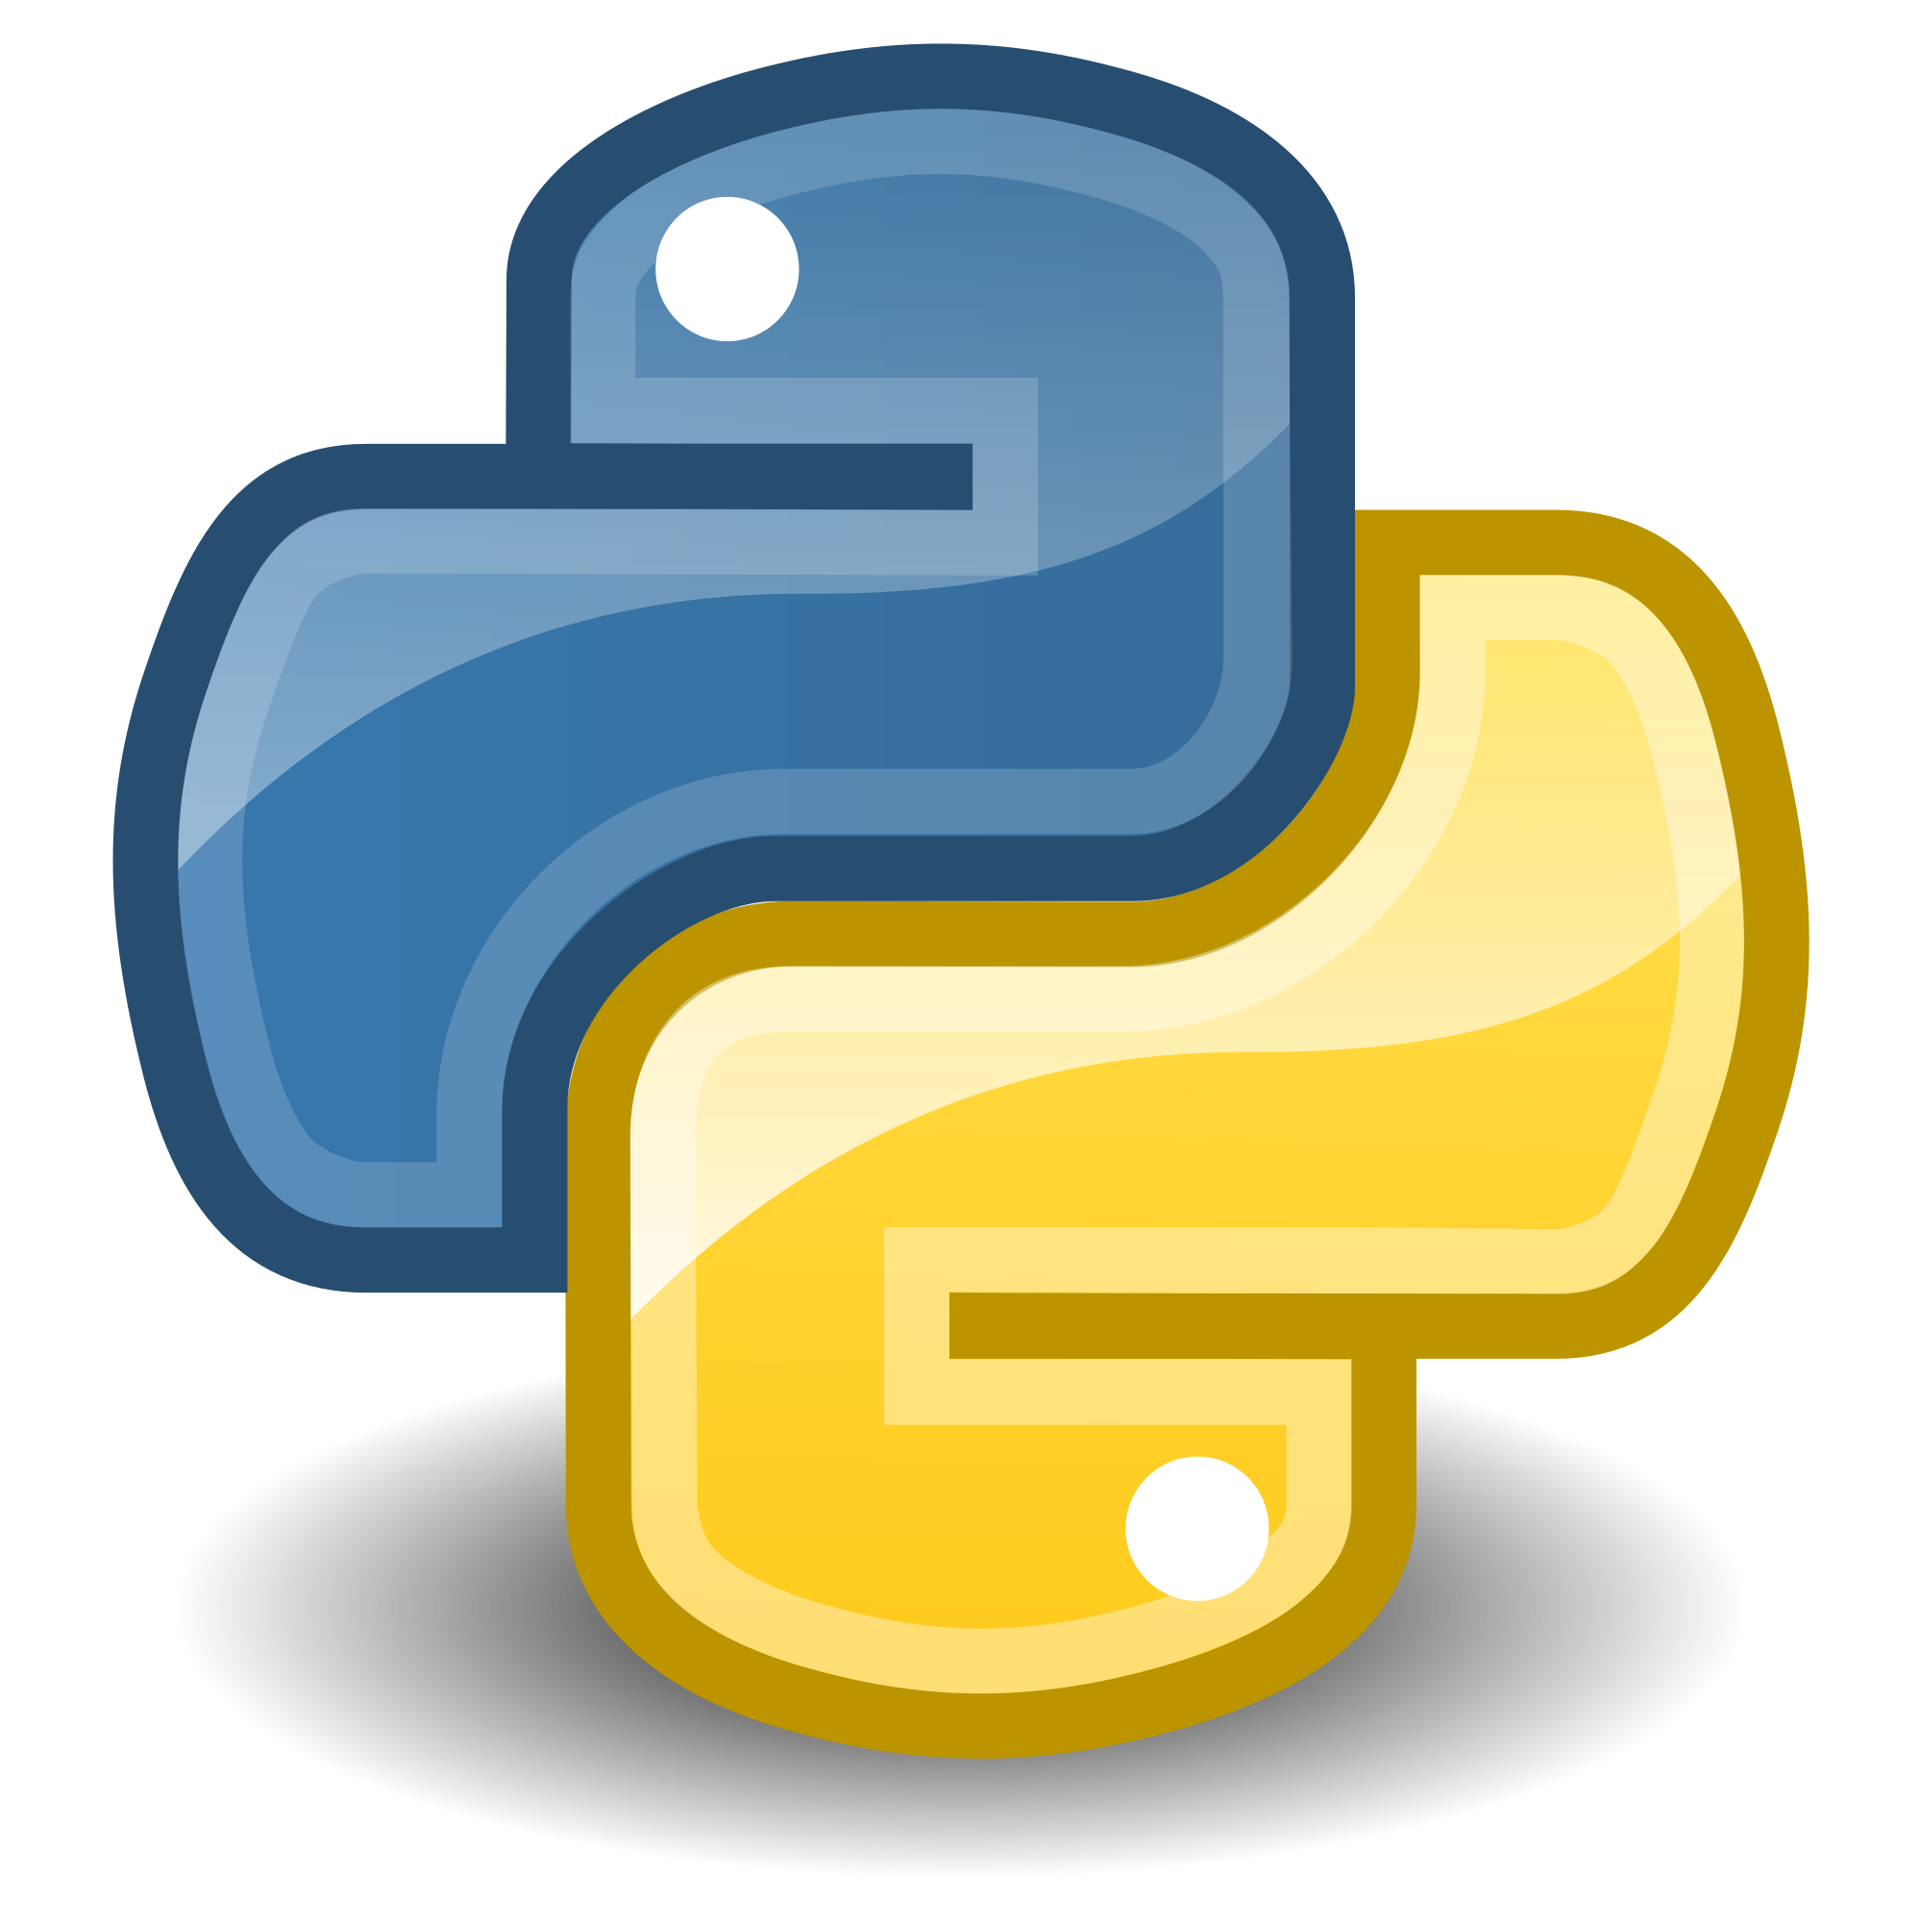
What is Python?
“Python is an interpreted, object-oriented, high-level programming language with dynamic semantics.”
100% Open Source
(Code is now on Github)
Python originally created 1990
Python 3 released December 2008

Slide 4
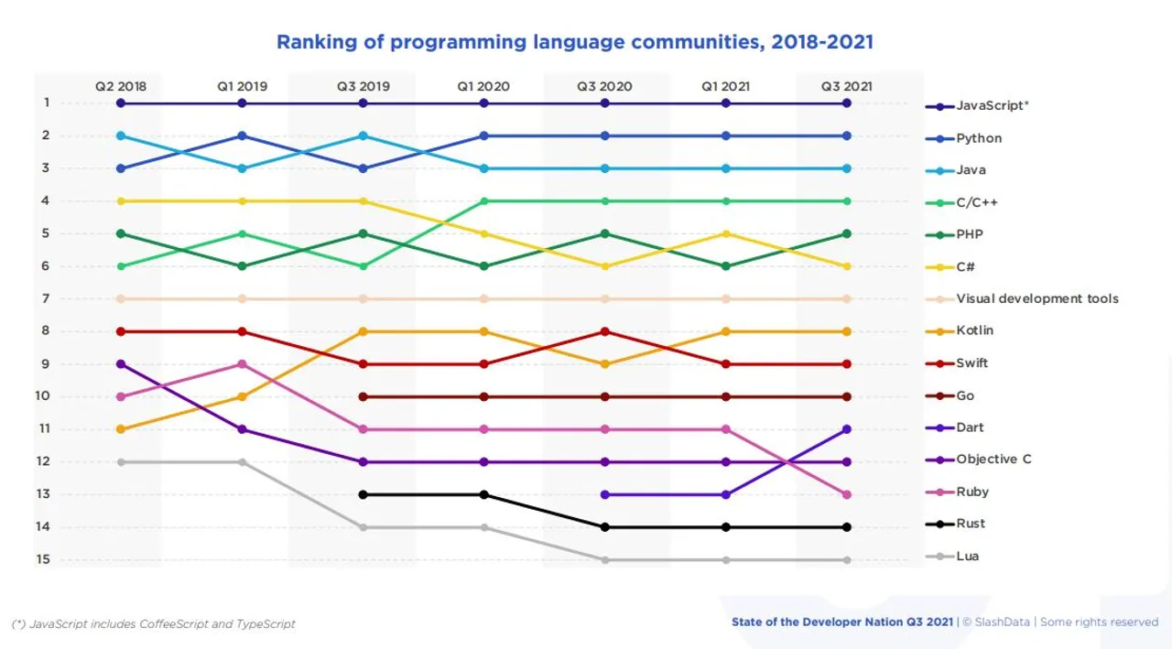
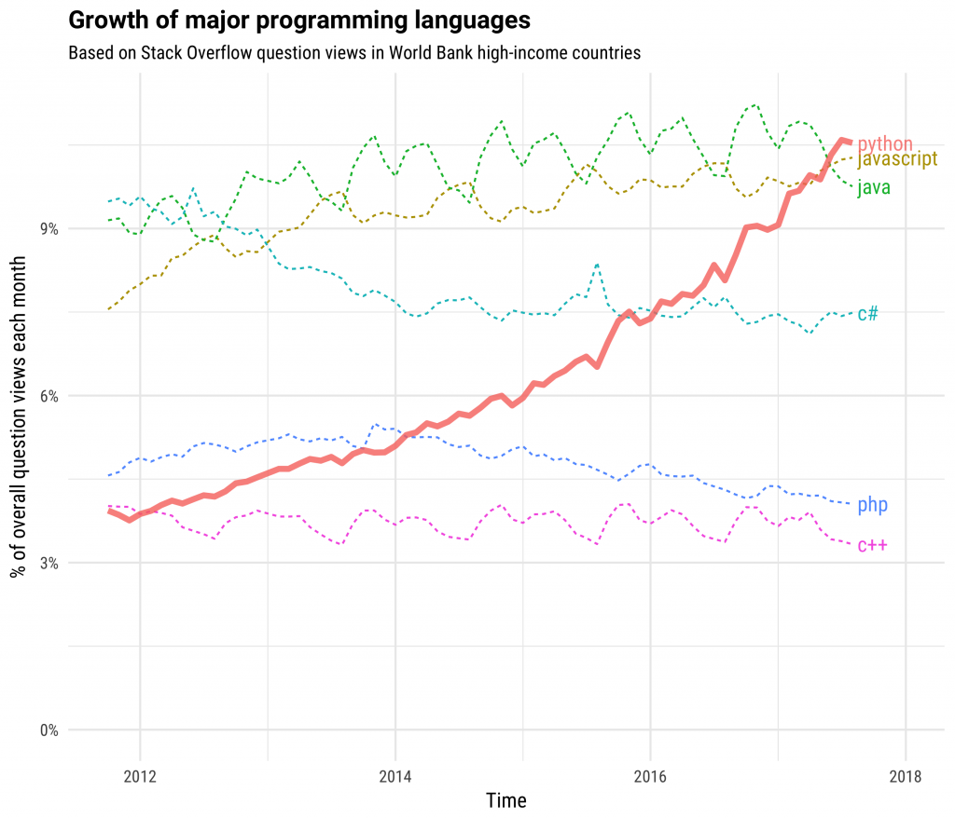
Why Python?
One of the fastest growing of the major programming languages
Users in every possible field
Libraries for every possible task
Runs on just about anything (including routers/switches!)
Portable code

Slide 5
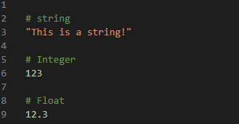
Python Basics: Strings, Integers, and Floats
Strings
Surrounded by quotation marks
Single or double quotes is fine, but choose one and stick to it
Integers
Positive or negative whole number with no decimal point
Floating
Positive or negative number with decimal point

Slide 6
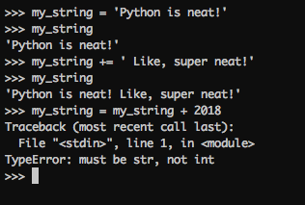
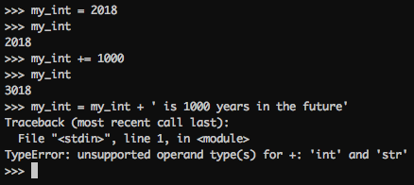
Python Basics: Assignments and Variables
Variables:
Store a value in an object
“=“ (Equals): Assigns values from right operand to left operand
Manipulating variables:
“+=“ (Plus Equals): Adds right operand to left operand
“-=“ (Minus Equals): Subtracts right operand to left operand

Slide 7
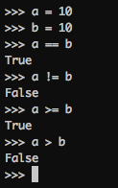
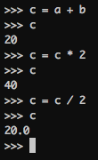
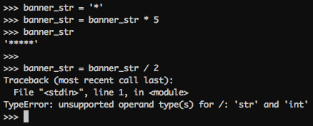
Python Basics: Logical and Math
Logical Operators
“==“ (Equals Equals): Compares operands on each side to test for equality
“!=“ (Bang Equals): Compares operands on each side to test for inequality
“<“ “>” (Less/Greater Than): Just like Math!
“<=“ “>=” (Less/Greater Than or Equal to): Just like Math! (still)
Math Operators
Python also has “normal” Math functionality:
“+” (Add) and “-“ (Subtract)
“/“ (Divide) and “*” (Multiply)
… and some interesting operations

Slide 8
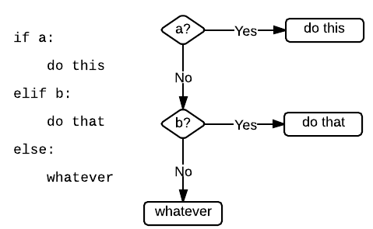
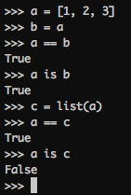
Python Basics: Conditional Logic
Identity:
“is” or “is not”
Compares two objects in *memory*
Boolean:
True or False
Conditionals:
IF condition is met
ELIF condition is met
Else (catch all)
Why is this not TRUE?
Notes:
It is false because we created a new object called “c” and “c” IS NOT “a”

Slide 9
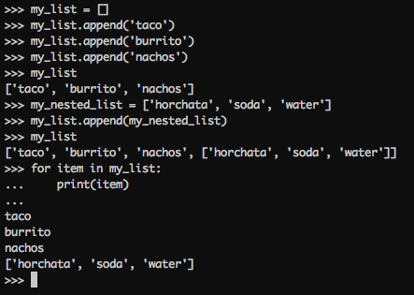
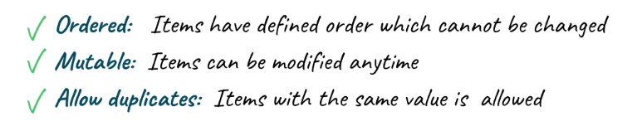
Python Basics: Data Structures - Lists
Live inside “square brackets”: [your list here]
Ordered, and iterable — lists are indexed
Lists can contain any data type and any mix of data types

Slide 10
Python Basics: Data Structures - Lists
What is the difference between a LIST and an ARRAY?
A list in Python is a collection of items which can contain elements of multiple data types, which may be either numeric, character logical values, etc.
An array is a vector containing homogeneous elements i.e. belonging to the same data type.
Lastly:
Arrays use pre-allocated memory and are fast and efficient.
Lists on the other hand are “built” as items are added, have high overhead, but are flexible

Slide 11
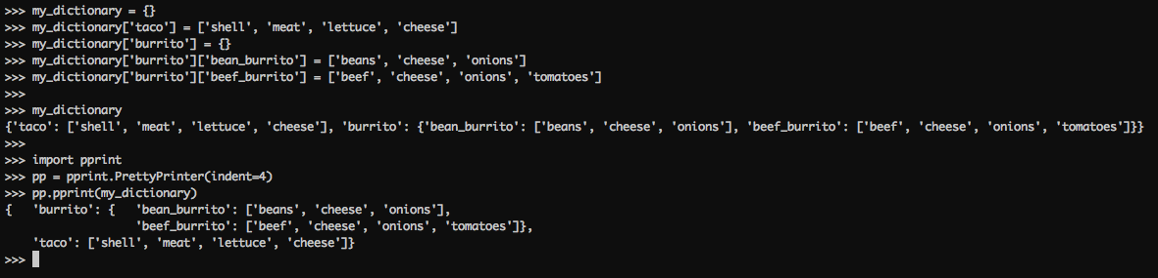
Python Basics: Data Structures - Dictionaries
Written in curly brackets:
{your dict here}
JSON-like format
Designed to contain Key:Value pairs, separated by commas.
my_dictionary = {1: “blue”, 2: “green”}
Data is accessed via the unique Key (ie., duplicate keys are not allowed)
Dictionaries can contain most data types (including other dictionaries)

Slide 12
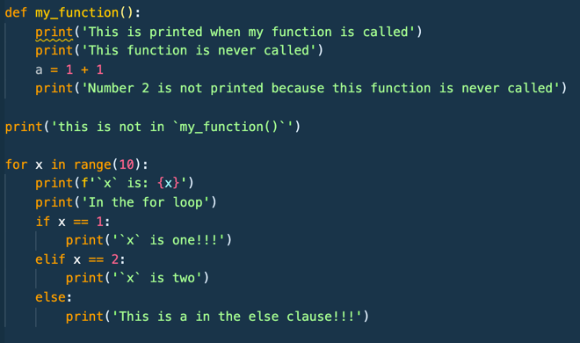
Python Basics: Whitespace Matters
In python, whitespace matters
Other languages use curly braces to indicate inclusion in a function, for loop, or if statement
Python uses spaces, the default is 4 spaces.
Don’t use tab characters, they’ll work but will mess up your code later on.
Most python IDE’s will replace the tab key with 4 spaces.

Slide 13
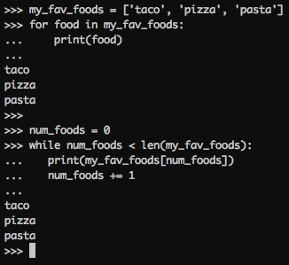
Python Basics: Loops
For Loop:
For each item in a thing
Iterates a *fixed* amount of time (num items in thing to be iterated upon)
While Loop:
While a condition is True
Iterates forever, until condition is changed

Slide 14
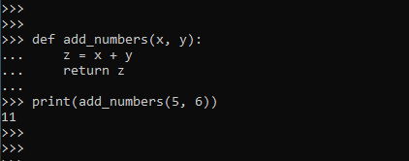
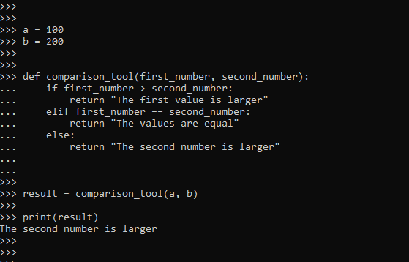
Python Basics: Functions
Block of reusable code that can be defined once, and called multiple times
Can contain its own variables, or reference ‘global’ variables
Takes zero or more arguments
Returns ‘something’

Slide 15
Python Basics: Libraries for Network Engineers
Interacting with CLIs
Netmiko
Interacting with APIs
http.client
Requests

Slide 16
Interacting with CLIs
using Python

Slide 17
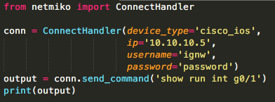
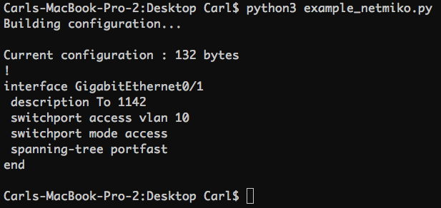
Netmiko
Library developed to interact with network devices
Built with Paramiko library
Abstracts some of the CLI intricacies
Many networking devices supported
IOS-XE, IOS-XR, NX-OS, ASA

Slide 18
Interacting with APIs
using Python

Slide 19
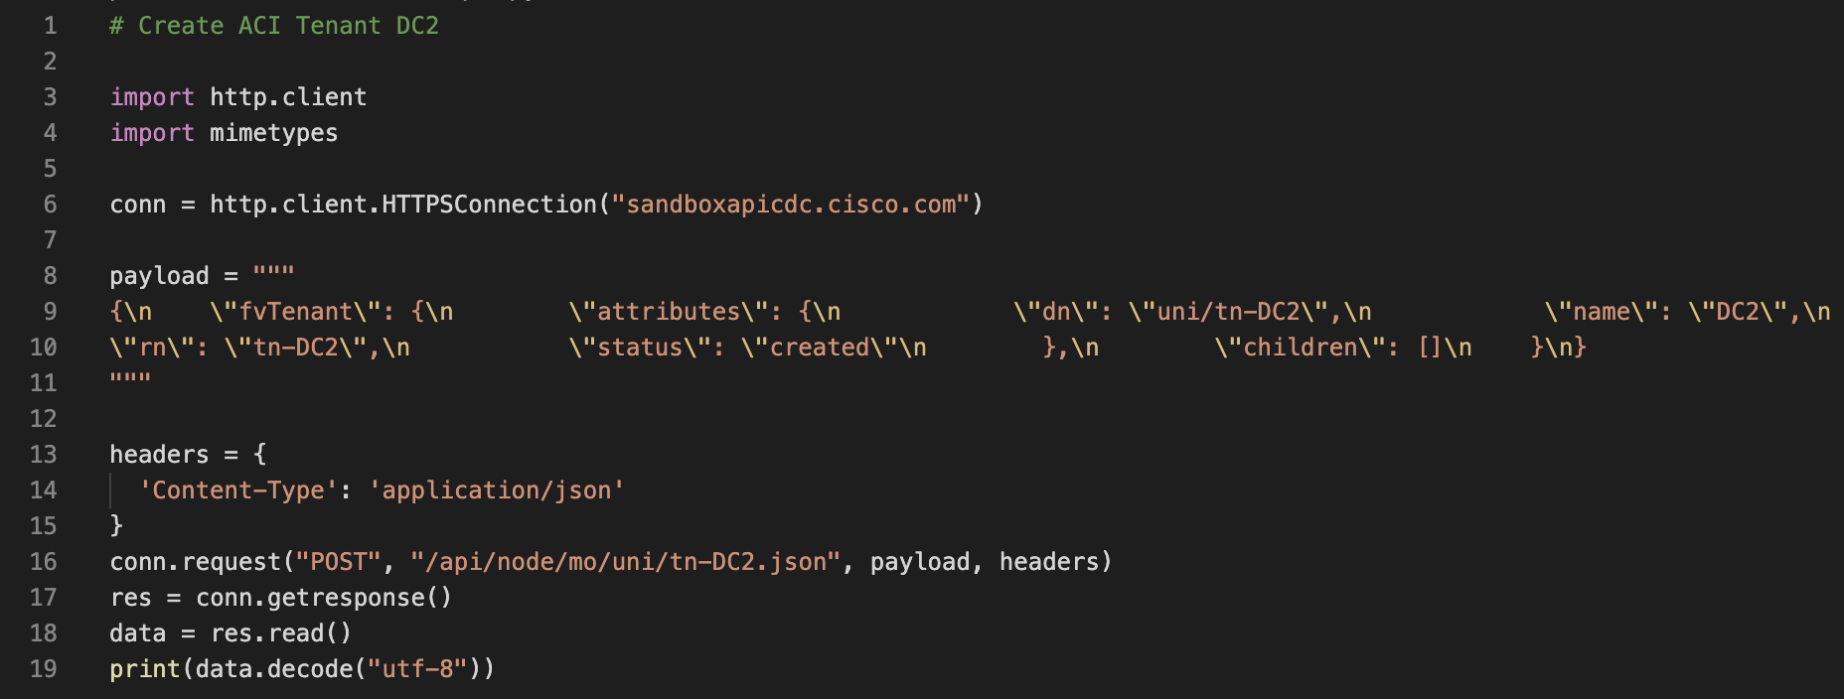
http.client
Python library for making HTTP requests
Enables network engineers to interact directly with APIs without using third-party libraries

Slide 20
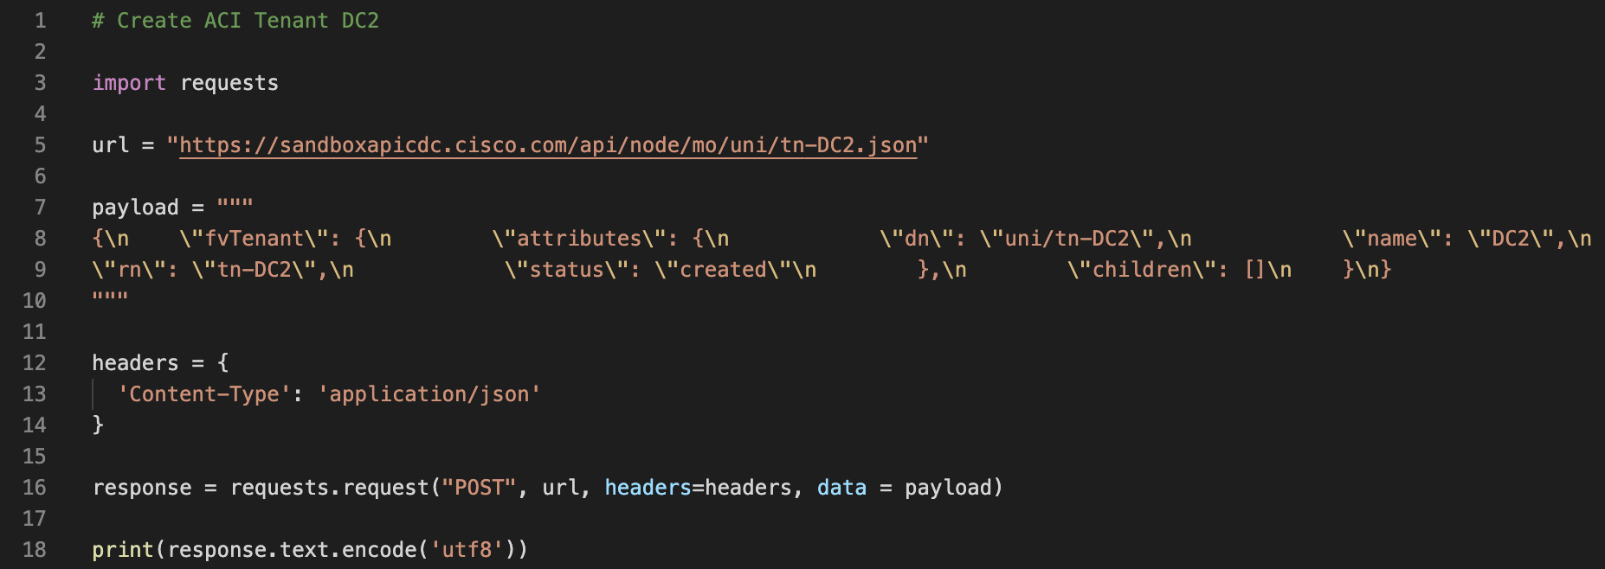
Requests
One of the most popular Python libraries
Simplifies API requests (easier than http.client)

Slide 21
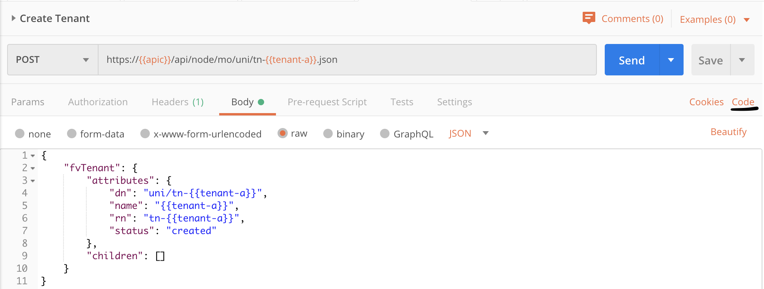
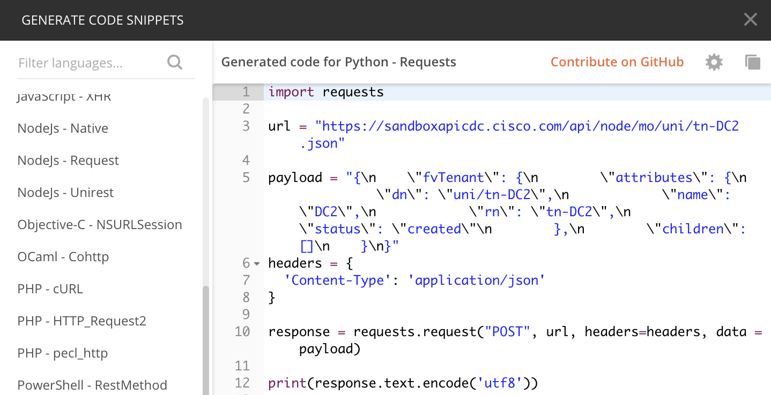
Using Postman to kickstart development
Postman can generate code snippets using existing API requests
Python libraries http.client and requests supported, as well as many different languages

Slide 22
Additional Resources
DevNet
Learn how to use Python to configure ACI, DNA Center, Meraki, and more
https://developer.cisco.com/
Learnpython.org
Free courses for Python
https://www.learnpython.org/
PythonAnywhere
Host, run, and code Python in the cloud
https://www.pythonanywhere.com/
Learn Python 3 the Hard Way
In-depth guide for learning Python
https://www.amazon.com/Learn-Python-Hard-Way-Introduction/dp/0134692888
Automate the Boring Stuff
How to do day to day tasks in python. Website free, can buy a book.
https://automatetheboringstuff.com/

Slide 23
Questions?

